Slide 1
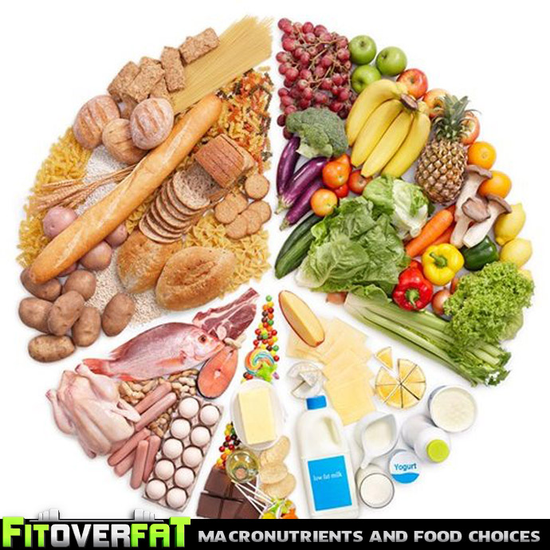
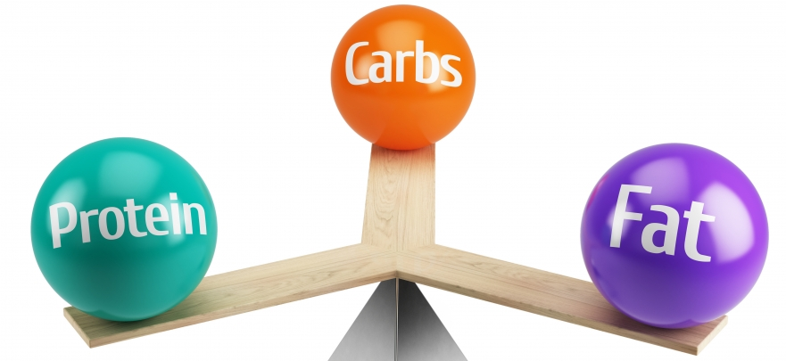
HEALTH AND LIFESTYLE CLASS - 3 MACRONUTRIENT IMBALANCE

Slide 2
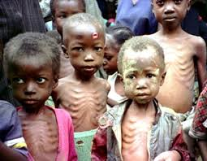
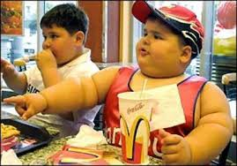
Malnutrition is a condition that results from eating a diet in which one or more nutrients are either not enough or are too much such that the diet causes health problems. It may involve calories, protein, carbohydrates, fat, vitamins or minerals.
Overnutrition is a form of malnutrition in which the intake of nutrients is oversupplied. The amount of nutrients exceeds the amount required for normal growth, development, and metabolism.
Undernutrition is a deficiency of calories or of one or more essential nutrients
MALNUTRITION
UNDERNUTRITION
OVERNUTRITION

Slide 3

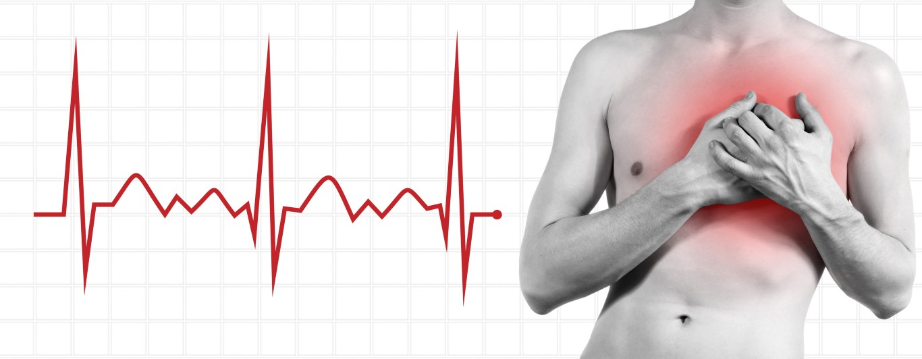

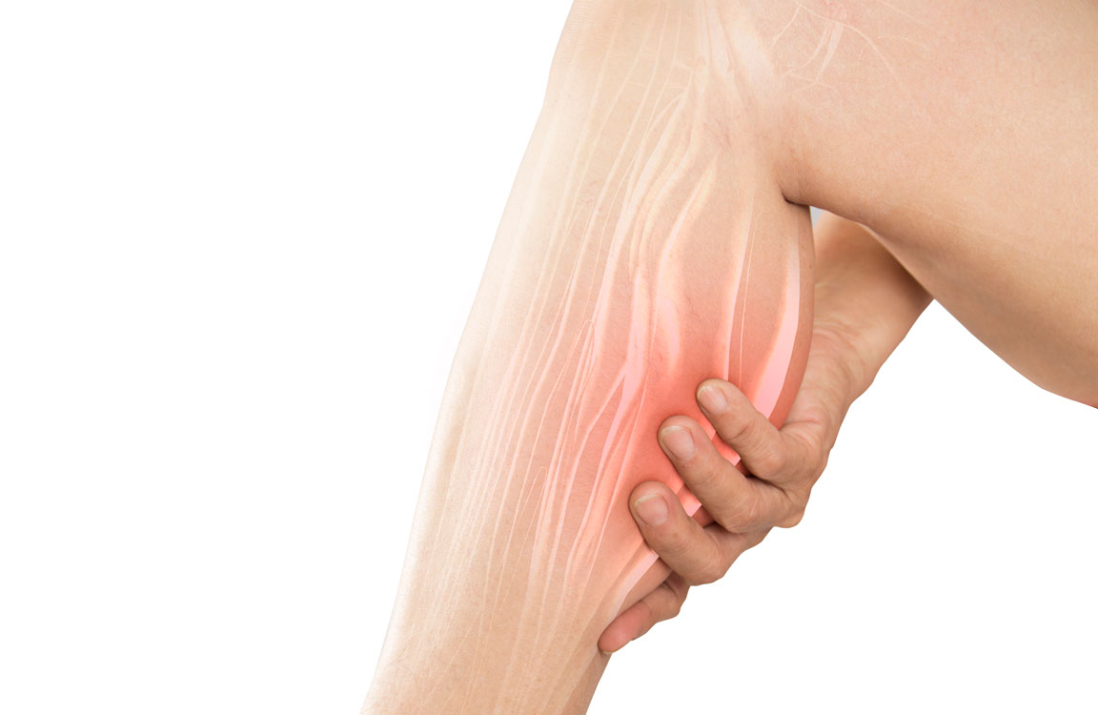
DEFICIENCY SYMPTOMS OF CARBOHYDRATES
Muscle cramps
Fatigue
Dizziness
Headache
Confusion
Sweating
Acidosis
Fast heart beat
Ketosis
Hypoglycemia
Constipation

Slide 4
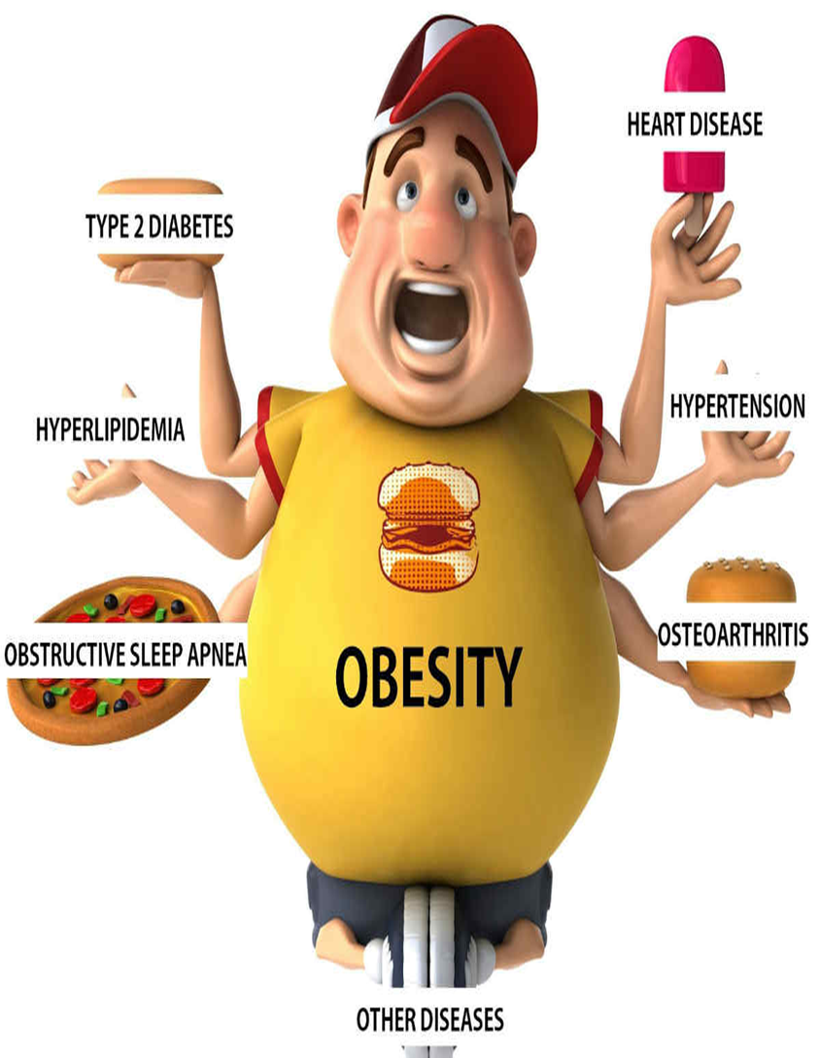
EXCESS CONDITIONS
Obesity....
Non-Insulin Dependent Diabetes mellitus (NIDDM) ...
Cardiovascular disease. ...
Cancer. ...
Gastrointestinal diseases. ...
Dental caries. ...

Slide 5

Find your answer
1. __________________ are examples of high energy high nutrient food
Fruits & vegetables
Chocolate & Ice cream
Milk & Cheese
Pancake & Maple syrup
2. When energy intake decreases and energy expenditure increases, body weight ______________.
Remains the Same
Goes Up
Goes Down
Is unstable

Slide 6


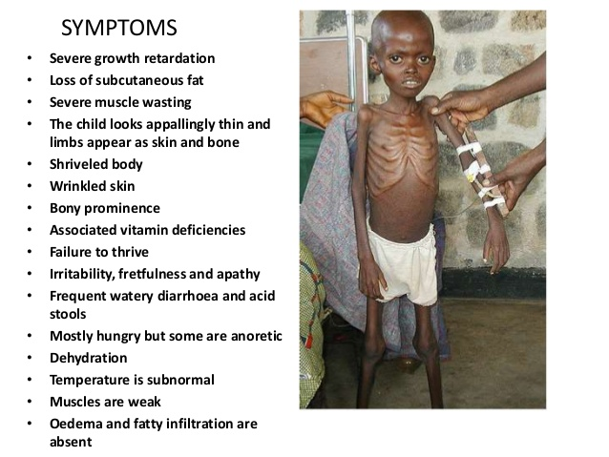

PROTEIN DEFICIENCY
Insufficient of protein may cause various health problems such as kwashiorkor, marasmus, impaired mental health, edema, organ failure, wasting and shrinkage of muscle tissues, and weakness of immune system.
SIGNS AND SYMPTOMS :
Skin, hair and nail problems.
Loss of muscle mass.
Increased risk of bone fractures.
Bigger appetite and increased calorie intake.
Risk of infections.
Fatty liver.
May inhibit proper body growth in children.

Slide 7
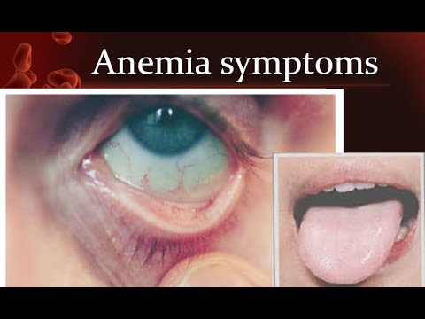
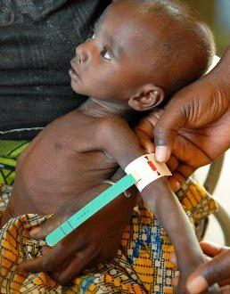

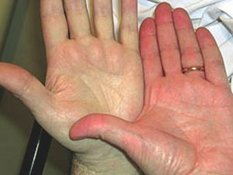
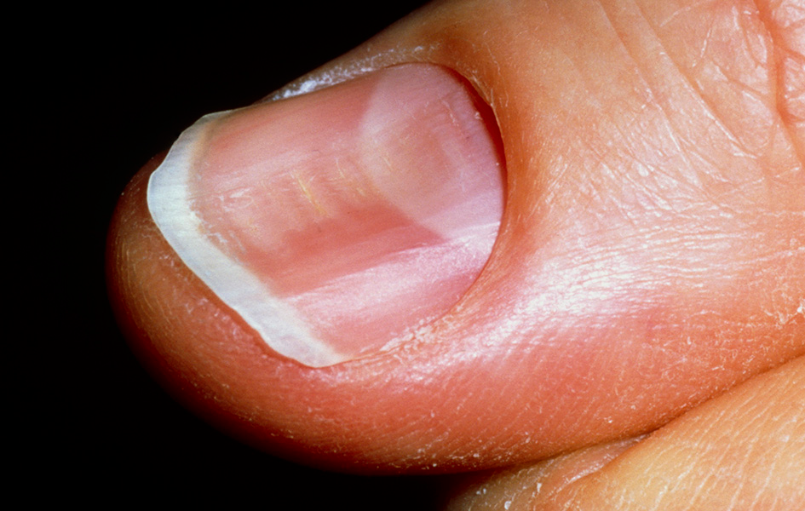
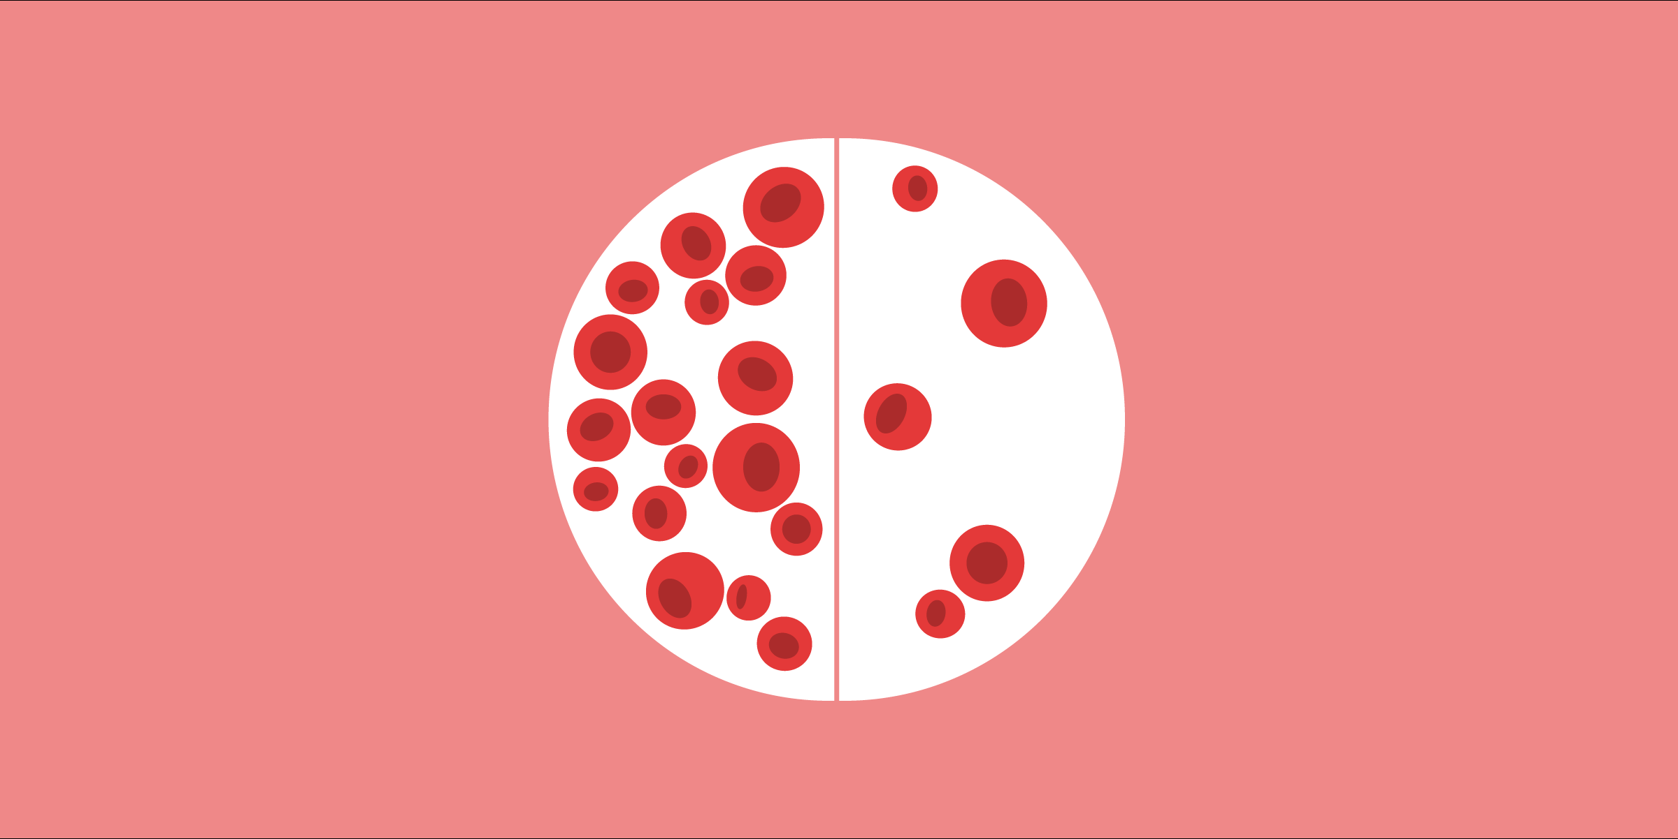
SYMPTOMS OF PROTEIN DEFICIENCY ANEMIA
PALE EYES
WEIGHT LOSS (MUSCLE WASTING)
TRANSVERSE LINES IN NAILS
PALE SKIN
SPOON SHAPED NAILS
LOWERED HB COunt

Slide 8
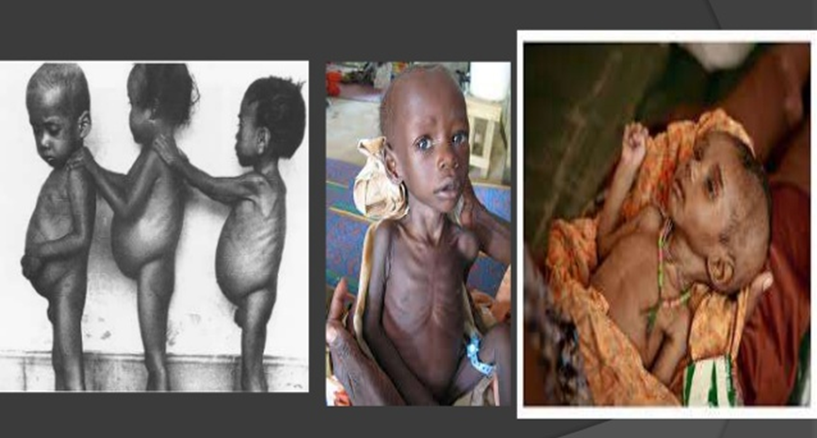
PROTEIN ENERGY MALNUTRITION
Protein–energy malnutrition (PEM), sometimes called protein-energy undernutrition (PEU), is a form of malnutrition that is defined as a range of pathological conditions arising from coincident lack of dietary protein and/or energy (calories) in varying proportions. The condition has mild, moderate, and severe degrees.
Types:
Kwashiorkor
Marasmus
Marasmic kwashiorkor

Slide 9
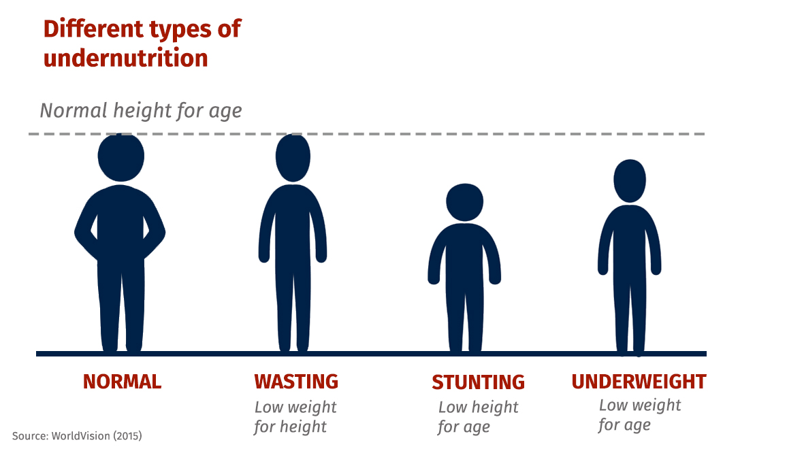

Slide 10
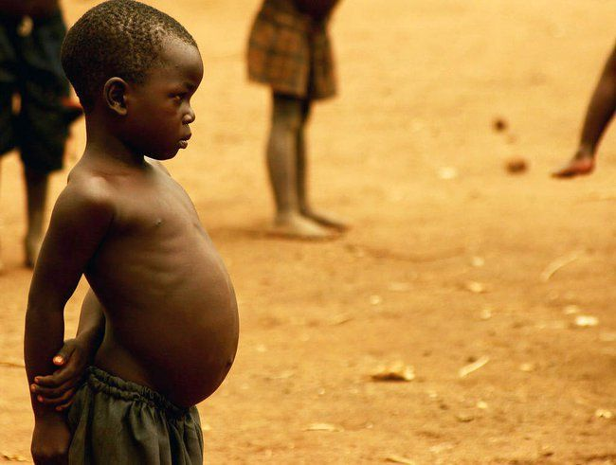
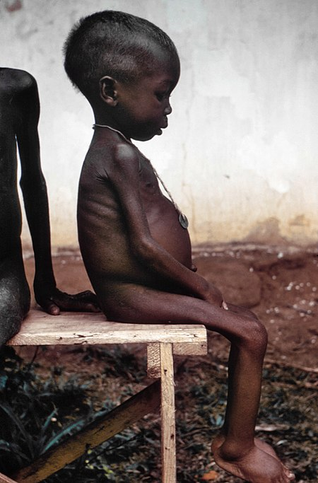
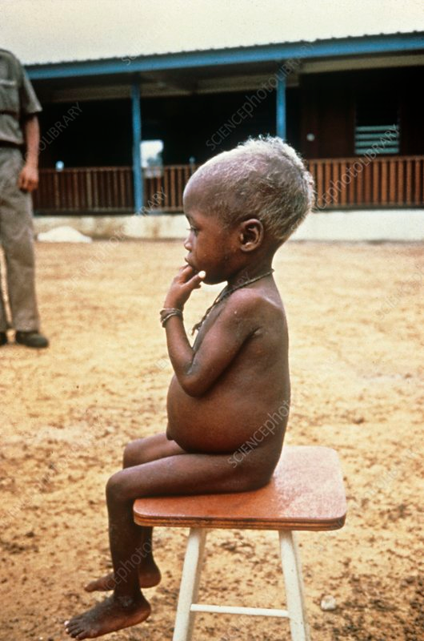
KWASHIORKOR (Calorie Deficiency)
Abdominal swelling, distension or bloating
Diarrhea
Enlarged liver
Fatigue
Odema
Hair and nail changes, including brittle, reddish hair that are thin and soft
Irritability
Muscle wasting
Skin changes, including pigment loss, peeling, cracking and sores
Slowed growth leading to short stature
Weight loss

Slide 11
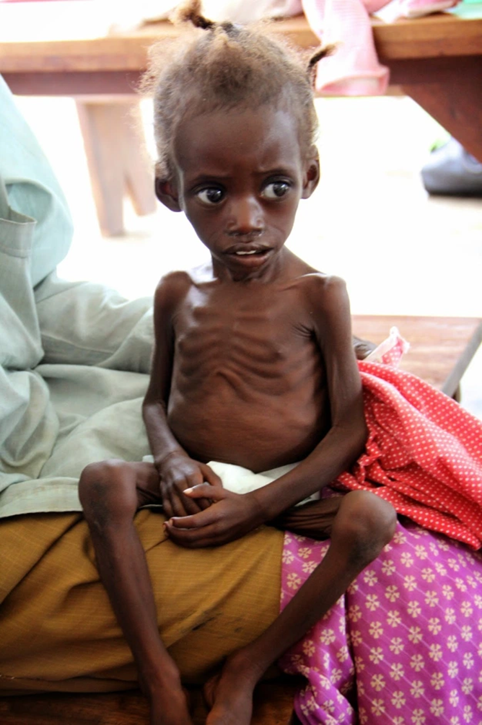
MARASMUS (Protein and Energy Deficiency)
Symptoms of Marasmus
Dizziness
Weight loss (Muscle wasting)
Dehydration.
Lack of energy
Stunted growth.
Chronic Diarrhoea.
Shrinkage of Stomach.
Respiratory infections.
Dry skin and brittle hair.
Underweight or loss of muscle mass and subcutaneous fat.

Slide 12
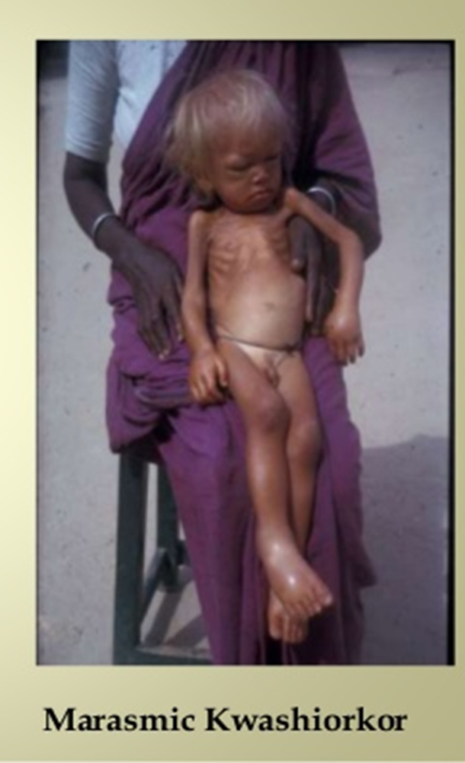
MARASMIC KWASHIORKOR
Marasmic kwashiorkor The most severe form of protein-energy malnutrition in children, with weight for height less than 60% of that expected, and with oedema and other symptoms of kwashiorkor.

Slide 13

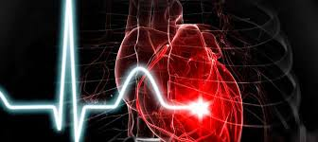
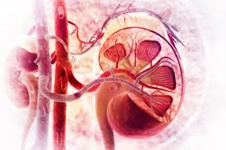
EXCESS PROTEIN LEADS TO:
Risks of eating too much protein
Weight gain.
Bad breath. ...
Constipation. ...
Diarrhea. ...
Dehydration. ...
Kidney damage. ...
Increased cancer risk.
Heart disease

Slide 14
Find your answer
Most underweight children live in:
South America
Africa
Latin America
Asia
2. Malnutrition can be caused by…
Household food insecurity
Inadequate care and feeding practices
Poor sanitation and lack public health services
All of the above

Slide 15
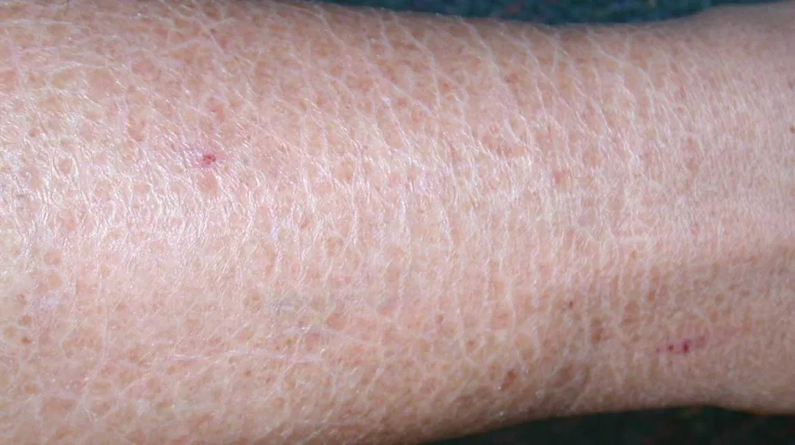
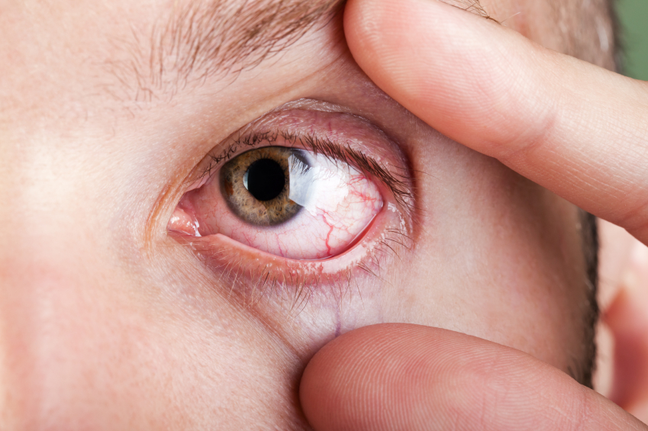

FATS
Signs of fat deficiency:
Dry and scaly skin.
Dry eyes.
Feeling constantly cold.
Dry hair and/or hair loss.
Hormonal problems, including loss of menstrual cycle.
Inability to feel full/always feeling hungry.
Issues concentrating and/or mental fatigue.
Deficiencies in fat-soluble vitamins.

Slide 16
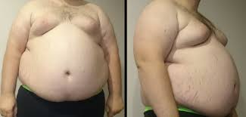
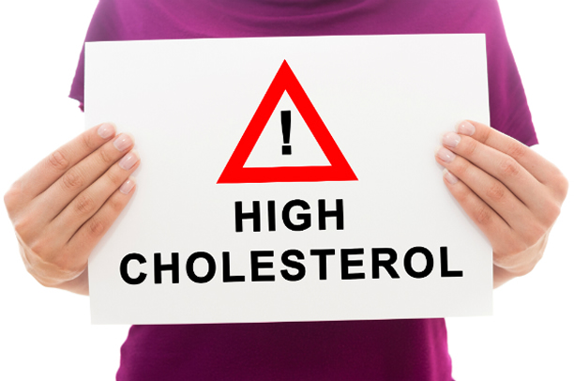
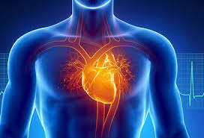
EXCESS FAT LEADS TO:
Eating too much saturated fats in your diet can raise "bad" LDL cholesterol in your blood
Increase the risk of Obesity, heart disease and stroke.

Slide 17
Find your answer
HDL and LDL Cholesterol are commonly known as _____ and ______ respectively.
Good cholesterol and Bad cholesterol
Bad cholesterol and Good cholesterol
Assimilatory cholesterol and oxidative cholesterol
Oxidative cholesterol and Assimilatory cholesterol
2. Rancidity of lipids of lipid-rich foodstuff is because of
Reduction of fatty acids
Hydrogenation of unsaturated fatty acids
Dehydrogenation of saturated fatty acids
Oxidation of fatty acids

Slide 18
REFERENCE BOOKS
Food Science- Srilakshmi, Prosper Montague Publishing Group Ltd., Hamlyn, London. 2003.
Food & Nutrition- Swaminathan, The Bangalore Printing & publishing co ltd., Vol I, Second Edition, Bangalore (1995).
An Introduction to Lifestyle Management: Facilitator’s Handbook, Dr. Anja Morris-Paxton, 2019
DEVELOPED RESOURCE MATERIALS
Macronutrient Imbalance: Developed PDF attached in Ample course content
LOCAL VIDEO :
www.youtube.com/watch?v=wxzc_2c6GMg - Video is available in Ample course content

Slide 19

HEALTHY EATING
HEATHY LIVING

